Slide 1


Md Amanullah Nayeem
7/31/2024

Slide 2

Outline
Executive Summary
Introduction
Methodology
Results
Conclusion
Appendix

Slide 3

Executive Summary
In this report, We have determined the price of each launch by gathering information about Space X and creating dashboards.
We also trained a machine learning model and use public information to predict if SpaceX will reuse the first stage.
From the various methods, we found Decision Tree get the more accurate prediction.

Slide 4
Introduction
The commercial space age is here, companies are making space travel affordable for everyone.
One reason SpaceX can do this is the rocket launches are relatively inexpensive because SpaceX can reuse the first stage.
Our Company, Space Y that would like to compete with SpaceX.
We need to determine the price of each launch.
We also need to determine if SpaceX will reuse the first stage.

Slide 5

Section 1

Slide 6
Methodology
Data collection methodology:
We have used SpaceX REST API, which give us data about launches, the rocket used, payload delivered, launch specifications, landing specifications, and landing outcome.
The SpaceX REST API endpoints starts with api.spacexdata.com/v4/.
We will use this URL to target a specific endpoint of the API to get past launch data.
We will perform a get request using the requests library to obtain the launch data, which we will use to get the data from the API.
This result can be viewed by calling the .json() method.
To convert this JSON to a dataframe, we have used the json_normalize function.
Falcon 9 Launch data obtained from web scraping related Wiki pages.

Slide 7
Methodology
Data collection methodology:
We have used the Python BeautifulSoup package to web scrape some HTML tables that contain valuable Falcon 9 launch records.
Then have parsed the data from those tables and convert them into a Pandas data frame for further visualization and analysis.
This raw data transformed into a clean dataset which provides meaningful data on the situation we are trying to address:
Wrangling Data using an API,
Sampling Data, and
Dealing with Nulls.

Slide 8
Methodology
Data collection methodology:
In some of the columns, we have an identification number.
We have used the API again targeting another endpoint to gather specific data for each ID number.
The data will be stored in lists and will be used to create our dataset.
Launch data includes data for the Falcon 1 booster, whereas we only want falcon 9.
We have filter/sample the data to remove Falcon 1 launches.

Slide 9
Methodology
Perform data wrangling
Some of the attributes:
Flight Number
Date
Booster version
Payload mass Orbit
Launch Site
Outcome : This is the status of the first stage Flights
Grid Fins: These help with landing Reused
Legs: used in landing pad
Block
Reused count
Serial
Longitude and latitude of launch

Slide 10
Methodology
Perform exploratory data analysis (EDA) using visualization and SQL
Perform interactive visual analytics using Folium and Plotly Dash

Slide 11
Methodology
Perform predictive analysis using classification models
We have build a machine learning pipeline to predict if the first stage of the Falcon 9 lands successfully.
This will include:
Preprocessing: Allowing to standardize our data
Train_test_split: Allowing to split data into training and testing data
Train the model and perform Grid Search to find the hyperparameters that allow a given algorithm to perform best.
Using the best hyperparameter values, we will determine the model with the best accuracy using the training data.

Slide 12
Methodology
Perform predictive analysis using classification models
We have test using:
Logistic Regression
Support Vector machines
Decision Tree Classifier
K-nearest neighbors.

Slide 13
Data Collection
We have defined a series of helper functions that will help us use the API to extract information using identification numbers in the launch data:
Rocket: https://api.spacexdata.com/v4/rockets/
Launch Pad: https://api.spacexdata.com/v4/launchpads/
Payloads: https://api.spacexdata.com/v4/payloads/
Cores: https://api.spacexdata.com/v4/cores
Rocket Launch Data: https://api.spacexdata.com/v4/launches/past with only the below columns:
'rocket', 'payloads', 'launchpad', 'cores', 'flight_number', 'date_utc'

Slide 14
Data Collection
Removed rows with multiple cores
Restricted the dates of the launches
Filter the Data Frame to only include `Falcon 9` launches

Slide 15
Data Collection – SpaceX API
GitHub URL of the completed SpaceX API calls notebook:
https://github.com/nym2010/Applied-Data-Science-Capstone/blob/2479d34100a407b3e1ca82fa04dd39822c548b4b/jupyter-labs-spacex-data-collection-api.ipynb
Data: Rocket Launch Data
Keep only Required Features
Remove Rows with Multiple Cores
Extract the single value for Cores and Payloads
Restrict the dates of the launches
Replace Identification Numbers to Names for Rocket, Payload, Launch Pad and Cores
Keep only`Falcon 9` launches
Remove NULLS
Remove Missing Values

Slide 16
Data Collection - Scraping
GitHub URL of the completed web scraping notebook:
https://github.com/nym2010/Applied-Data-Science-Capstone/blob/2479d34100a407b3e1ca82fa04dd39822c548b4b/jupyter-labs-webscraping.ipynb
soup: Falcon 9 launch records from Wikipedia
Extract all column/variable names from the HTML table header
Create a data frame by parsing the launch HTML tables

Slide 17
Data Wrangling
GitHub URL of the completed web scraping notebook:
https://github.com/nym2010/Applied-Data-Science-Capstone/blob/2479d34100a407b3e1ca82fa04dd39822c548b4b/labs-jupyter-spacex-Data%20wrangling.ipynb
df: Space X dataset
Calculate the number of launches on each site
Calculate the number and occurrence of each orbit
Calculate the number and occurence of mission outcome of the orbits
Create a landing outcome label from Outcome column

Slide 18
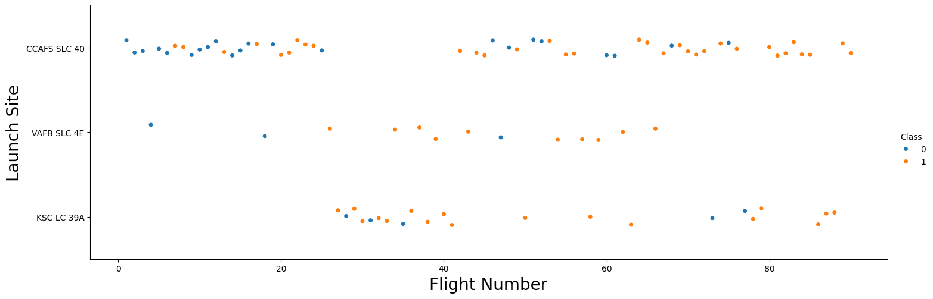
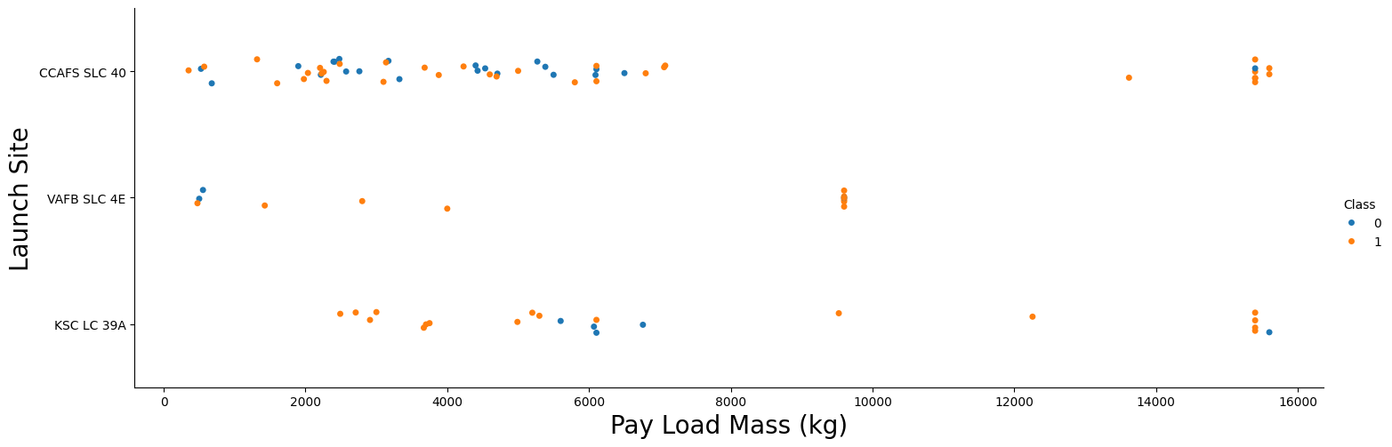
EDA with Data Visualization
GitHub URL of the completed web scraping notebook:
https://github.com/nym2010/Applied-Data-Science-Capstone/blob/2479d34100a407b3e1ca82fa04dd39822c548b4b/jupyter-labs-eda-dataviz.ipynb

Slide 19
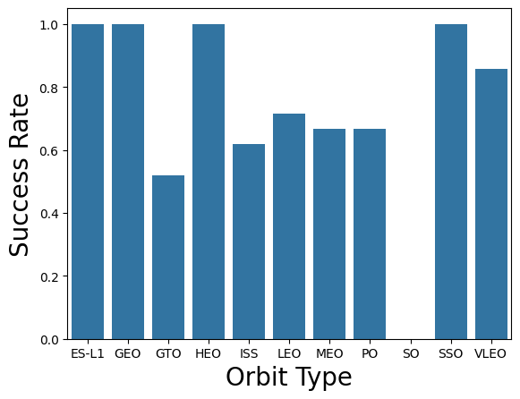
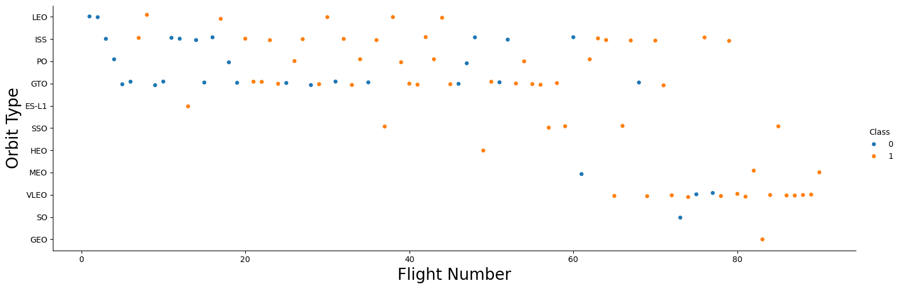
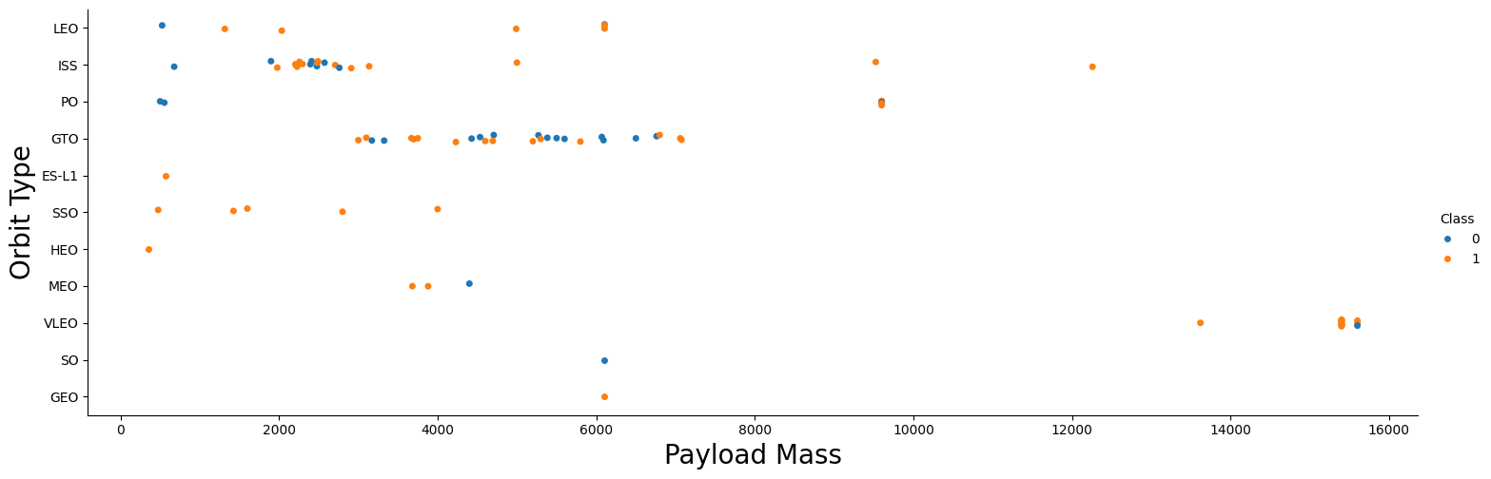
EDA with Data Visualization

Slide 20
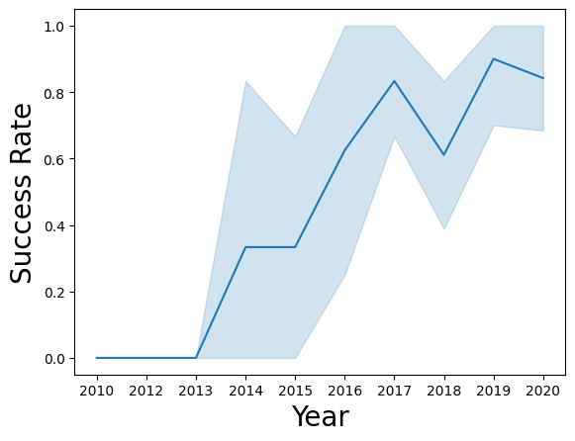
EDA with Data Visualization

Slide 21
EDA with SQL
GitHub URL of the completed web scraping notebook:
https://github.com/nym2010/Applied-Data-Science-Capstone/blob/2479d34100a407b3e1ca82fa04dd39822c548b4b/jupyter-labs-eda-sql-coursera_sqllite.ipynb

Slide 22
Build an Interactive Map with Folium
Map objects created:
Map: Create a map with all Launch Sites
Markers: Create an icon as a text label
Circles: Add a highlighted circle area with a text label on Launch Sites
Marker Cluster: To simplify a map containing many markers having the same coordinate
Line: To understand the distance between any location and Launch Sites
Explain why you added those objects
GitHub URL of your completed interactive map with Folium map :
https://github.com/nym2010/Applied-Data-Science-Capstone/blob/2479d34100a407b3e1ca82fa04dd39822c548b4b/lab_jupyter_launch_site_location.ipynb

Slide 23
Build a Dashboard with Plotly Dash
Here we have created plots and interactions in the Dashboard:
Total Success Rates based for:
All Launch Sites
Any one of the Launch Sites
Correlation Between Payload and Success for:
All Launch Sites
Any one of the Launch Sites

Slide 24
Build a Dashboard with Plotly Dash
GitHub URL of our completed Plotly Dash lab:
https://github.com/nym2010/Applied-Data-Science-Capstone/blob/main/All_Sites_Launch_Dashboard_1.png
https://github.com/nym2010/Applied-Data-Science-Capstone/blob/main/All_Sites_Launch_Ranger_1.png
https://github.com/nym2010/Applied-Data-Science-Capstone/blob/main/Specific_Sites_Launch_Dashboard_1.png
https://github.com/nym2010/Applied-Data-Science-Capstone/blob/main/Specific_Sites_Launch_Ranger_1.png

Slide 25
Predictive Analysis (Classification)
data: Space X dataset
X= Input Features Y = Output Features
Standardized and Transform X
Generate X_train, X_test, Y_train, Y_test
Create GridSearchCV using Individual Machine Learning Models
Fit using X_train and Y_train
Generate R2 Score and Accuracy for Individual Machine Learning Models
Select best performing classification model
We have test using:
Logistic Regression
Support Vector machines
Decision Tree Classifier
K-nearest neighbors
We have used R2 Score and Accuracy to find the best performing classification model.
GitHub URL of completed predictive analysis lab: https://github.com/nym2010/Applied-Data-Science-Capstone/blob/main/SpaceX_Machine_Learning_Prediction_Part_5.jupyterlite.ipynb

Slide 26
Results
Exploratory data analysis results
When Flight number increases, the first stage is more likely to land successfully.
While more massive the payload, the less likely the first stage will return.
ES-L1, GEO, HEO and SSO have higher success rate.
For VAFB-SLC launch site there are no rockets launched for heavy payload mass(greater than 10000).
LEO orbit the Success appears related to the number of flights but no relationship between flight number when in GTO orbit.
With heavy payloads the successful landing rate are more for Polar, LEO and ISS., but not for GTO.
Success rate since 2013 kept increasing till 2017 (stable in 2014) and after 2015 it started increasing.

Slide 27
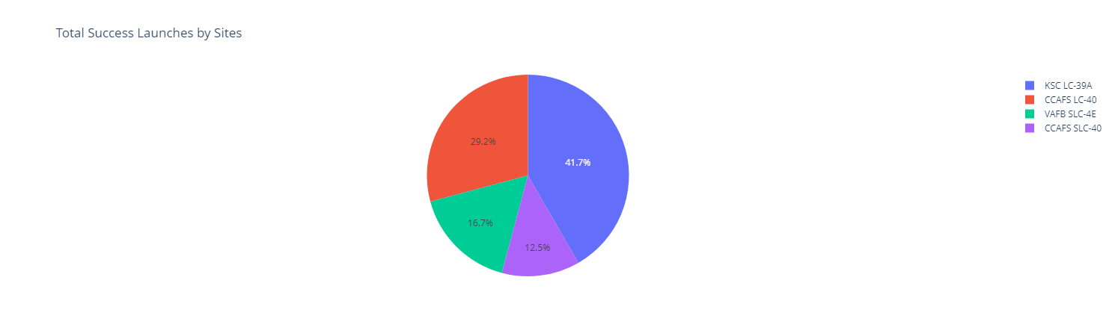

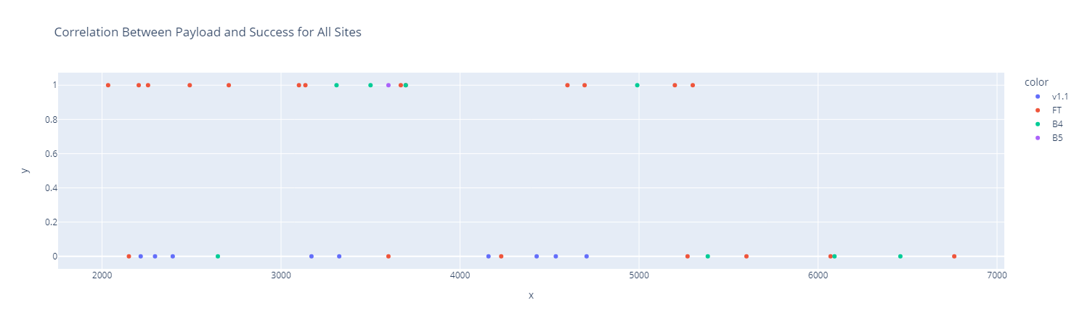
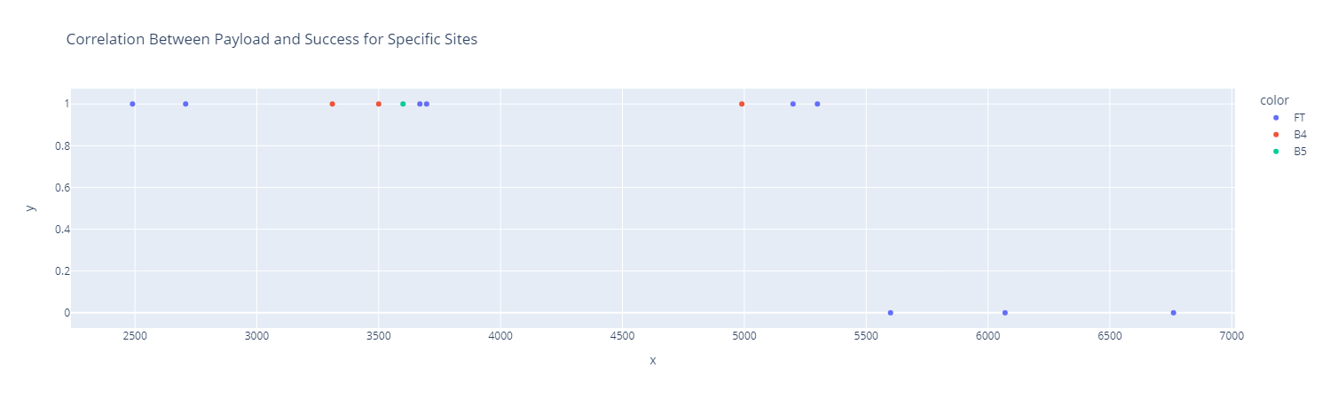
Results
Interactive analytics demo in screenshots

Slide 28
Results
Predictive analysis results

Slide 29

Section 2

Slide 30
Flight Number vs. Launch Site
When Flight number increases, the first stage is more likely to land successfully.

Slide 31
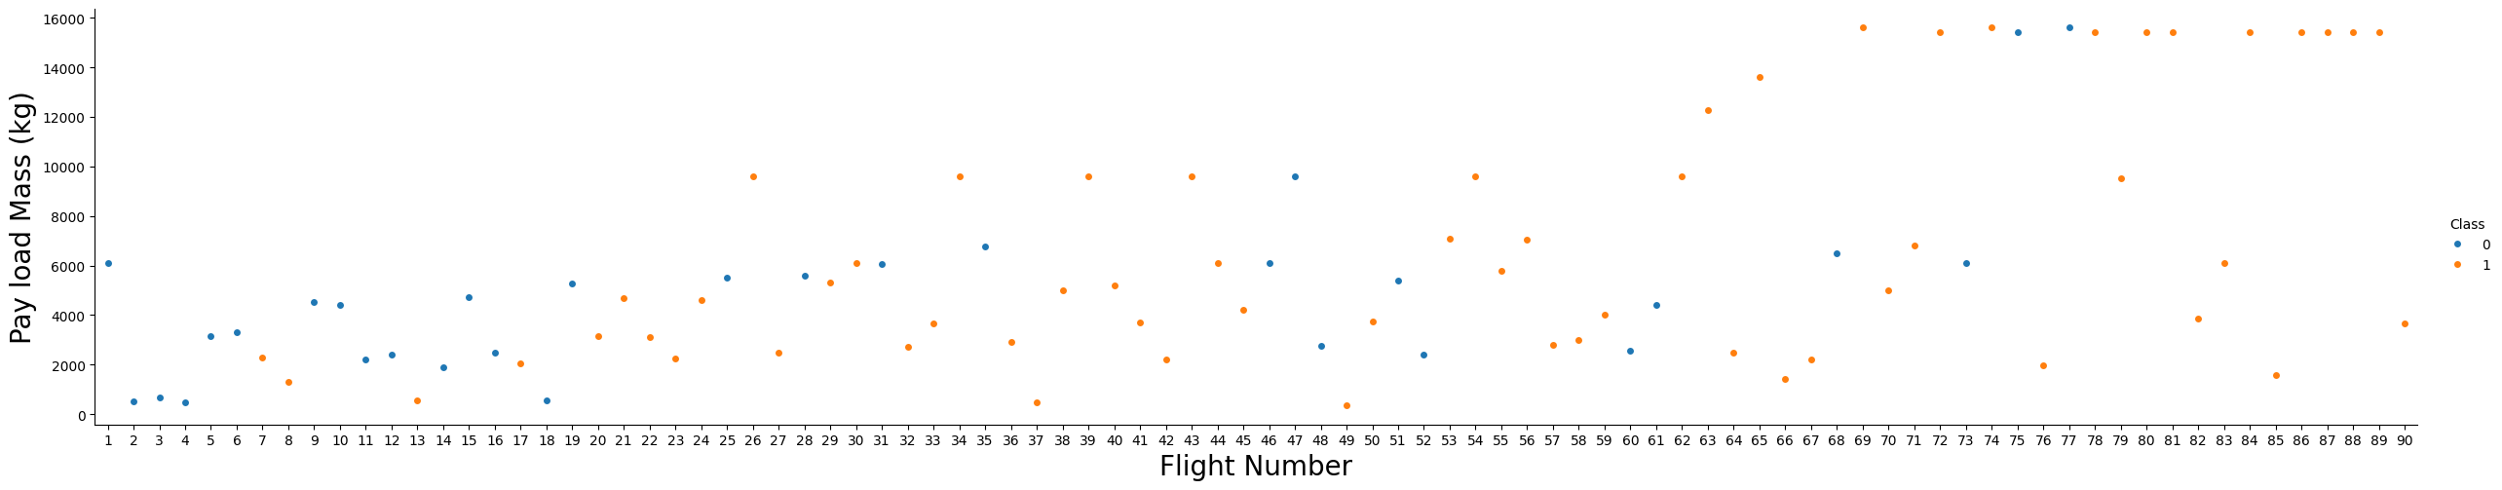
Payload vs. Launch Site
While more massive the payload, the less likely the first stage will return.

Slide 32
Success Rate vs. Orbit Type
ES-L1, GEO, HEO and SSO have higher success rate.

Slide 33
Flight Number vs. Orbit Type
LEO orbit the Success appears related to the number of flights but no relationship between flight number when in GTO orbit.

Slide 34
Payload vs. Orbit Type
With heavy payloads the successful landing rate are more for Polar, LEO and ISS., but not for GTO.

Slide 35
Launch Success Yearly Trend
Success rate since 2013 kept increasing till 2017 (stable in 2014) and after 2015 it started increasing.

Slide 36
All Launch Site Names
All Launch Sites are:

Slide 37
Launch Site Names Begin with 'CCA'
5 records where launch sites begin with `CCA`

Slide 38
Total Payload Mass
Total payload carried by boosters from NASA

Slide 39
Average Payload Mass by F9 v1.1
Average payload mass carried by booster version F9 v1.1

Slide 40
First Successful Ground Landing Date
Date of the first successful landing outcome on ground pad

Slide 41
Successful Drone Ship Landing with Payload between 4000 and 6000
Names of boosters which have successfully landed on drone ship and had payload mass greater than 4000 but less than 6000

Slide 42
Total Number of Successful and Failure Mission Outcomes
Total number of successful and failure mission outcomes

Slide 43
Boosters Carried Maximum Payload
Booster which have carried the maximum payload mass

Slide 44
2015 Launch Records
Failed landing_outcomes in drone ship, their booster versions, and launch site names for in year 2015

Slide 45
Rank Landing Outcomes Between 2010-06-04 and 2017-03-20
Rank the count of landing outcomes (such as Failure (drone ship) or Success (ground pad)) between the date 2010-06-04 and 2017-03-20, in descending order

Slide 46

Section 3

Slide 47
All Launch Sites’ Location Markers

Slide 48
Color-labeled Launch Outcomes on the Map

Slide 49
Selected launch site to its proximities with distance calculated and displayed

Slide 50

Section 4

Slide 51
Launch Success Count for all Sites

Slide 52
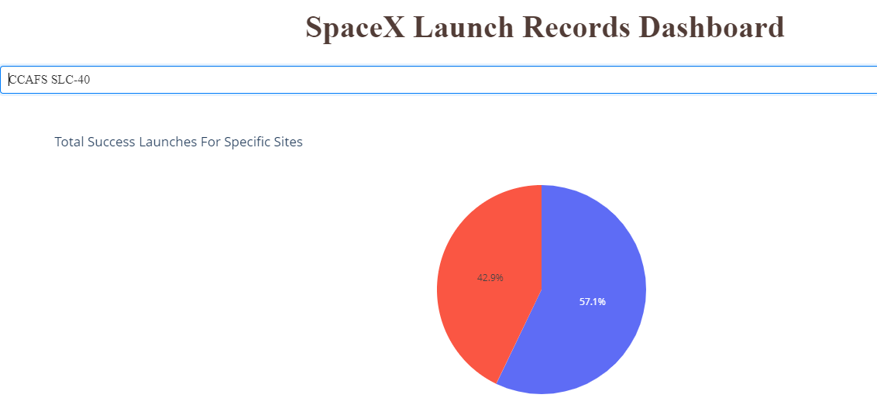
Launch Site with Highest Launch Success Ratio

Slide 53
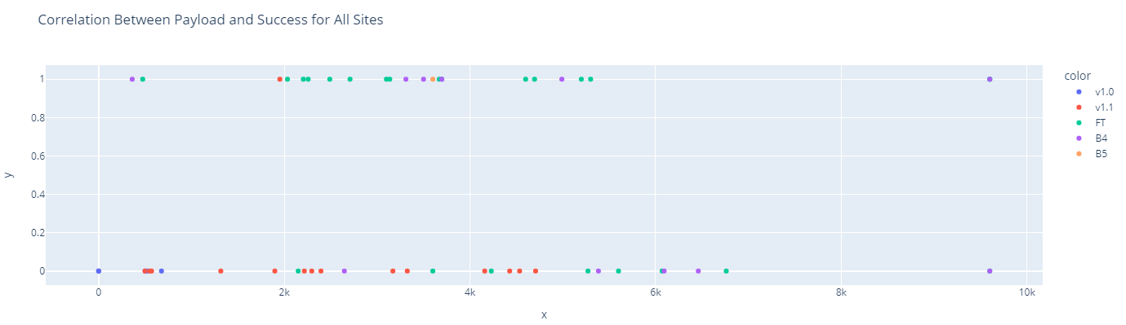
Payload vs. Launch Outcome scatter plot for all sites

Slide 54

Section 5

Slide 55
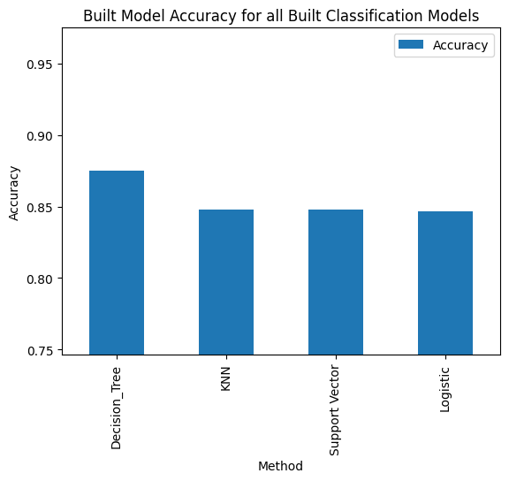
Classification Accuracy
Built Model Accuracy for all Built Classification Models
Decision Tree has the highest Accuracy

Slide 56

Confusion Matrix
Confusion matrix of the best performing model : Decision Tree
As shown, the False Positive is the lowest, we can say Decision Tree is the best performing method

Slide 57
Conclusions
When Flight number increases, the first stage is more likely to land successfully.
While more massive the payload, the less likely the first stage will return.
ES-L1, GEO, HEO and SSO have higher success rate.
For VAFB-SLC launch site there are no rockets launched for heavy payload mass(greater than 10000).
LEO orbit the Success appears related to the number of flights but no relationship between flight number when in GTO orbit.
With heavy payloads the successful landing rate are more for Polar, LEO and ISS., but not for GTO.
Success rate since 2013 kept increasing till 2017 (stable in 2014) and after 2015 it started increasing.

Slide 58


